Slide 1



Internship Project 3 at Mentorness
ICC CWC 2023 Exploratory Data Analysis
By Siddhant Ghosh

Slide 2


CONTENT
01
ABOUT THE DATASET
02
TEAM PERFORMANCE ANALYSIS
03
PLAYER PERFORMANCE ANALYSIS
04
OPPOSITION AND GROUND ANALYSIS
05
TEMPORAL ANALYSIS

Slide 3


Case Study: ICC CWC Analysis
1
Uncovering Patterns and Trends in the Cricket World Cup 2023 Dataset
2
The dataset has 1408 rows and 20 columns. There are 6194 missing values in the
dataset.
3
The dataset has data upto the semifinal matches only.

Slide 4
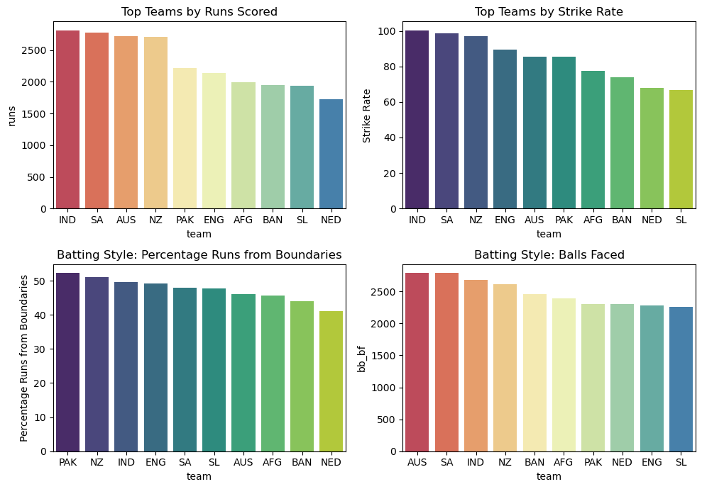
Team Performance Analysis - Batting
MOST RUNS SCORED BY INDIA
HIGHEST STRIKE RATE BY INDIA
THE HIGHEST PERCENTAGE OF RUNS FROM BOUNDARIES BY PAKISTAN
MOST BALLS FACED BY AUSTRALIA

Slide 5
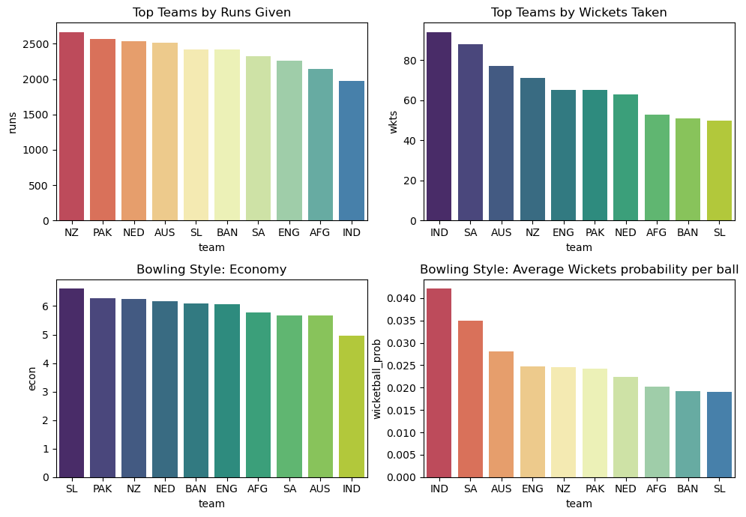
Team Performance Analysis - Bowling
NEW ZEALAND: TOP TEAM FOR CONCEDING THE MOST RUNS
INDIA: HIGHEST WICKETS TAKEN BY A TEAM
SRI LANKA: HIGHEST TEAM ECONOMY RATE
INDIA: LOWEST TEAM AVERAGE WICKET PROBABILITY, INDICATING EFFECTIVENESS IN TAKING WICKETS

Slide 6
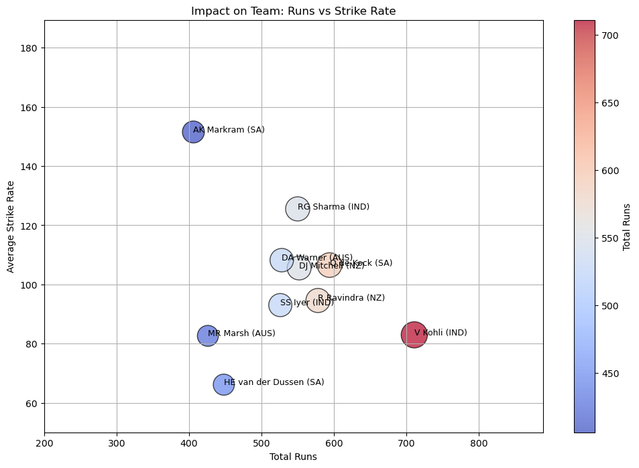
Top 10 Players by Impact - Batting

Slide 7
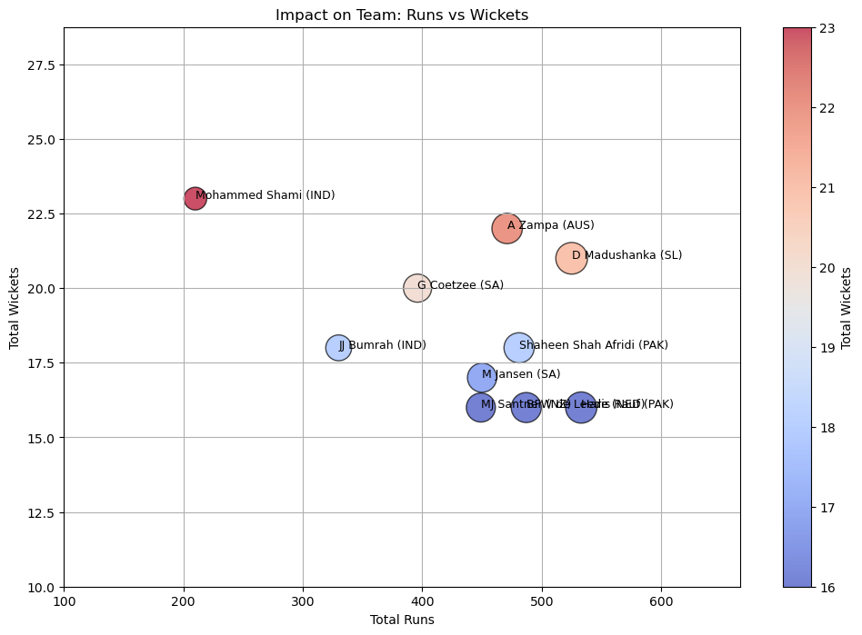
Top 10 Players by Impact - Bowling

Slide 8
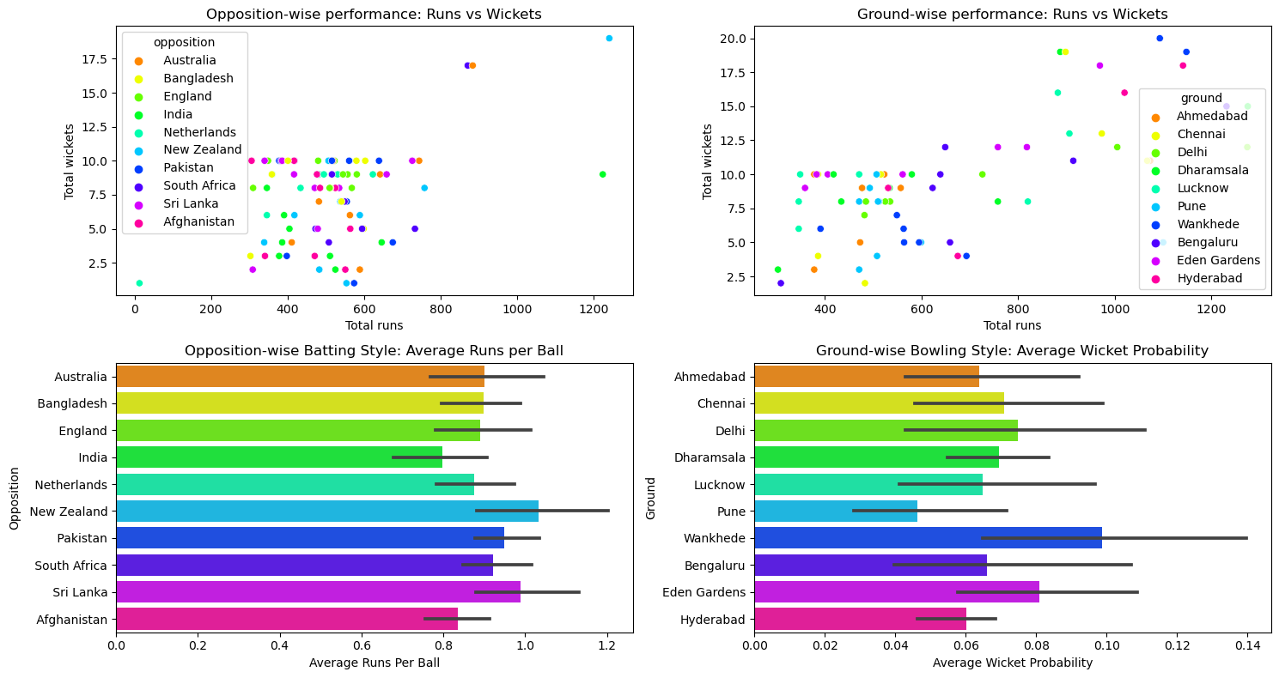
Some metrics by opposition wise and ground wise

Slide 9
Some metrics by opposition wise and ground wise

Slide 10
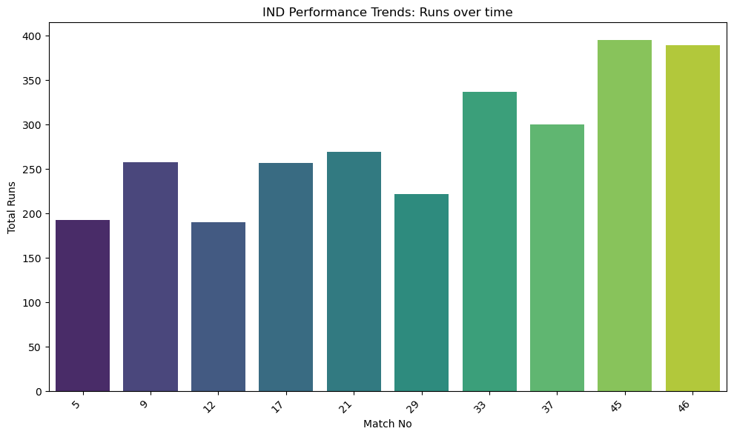
Temporal Analysis of India’s Performace : Batting

Slide 11
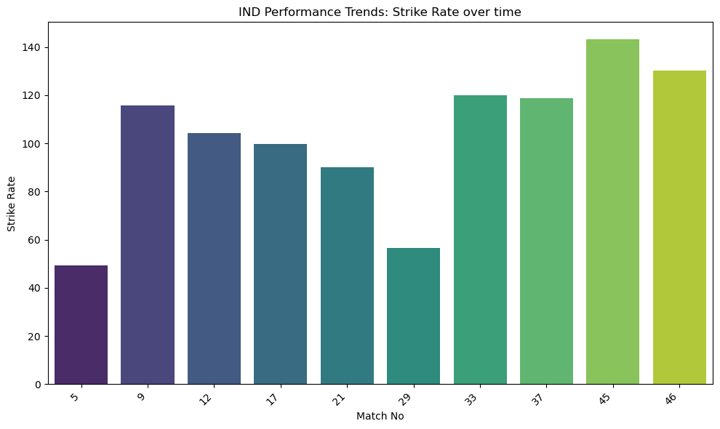
Temporal Analysis of India’s Performace : Batting

Slide 12
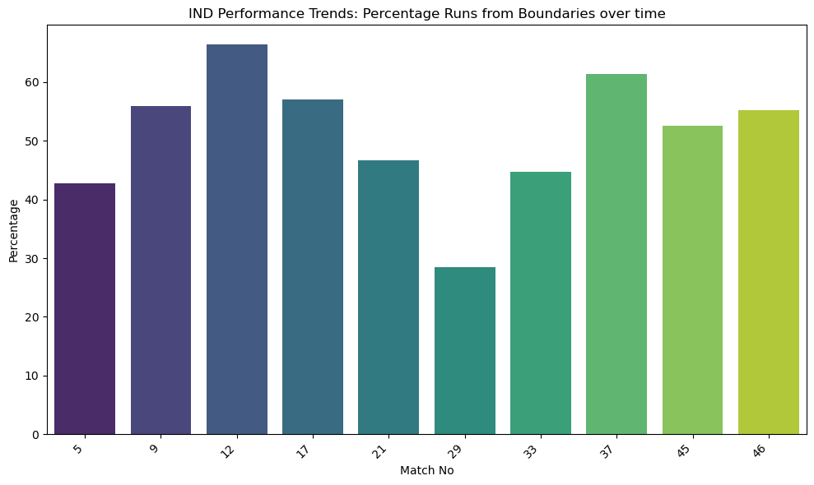
Temporal Analysis of India’s Performace : Batting

Slide 13
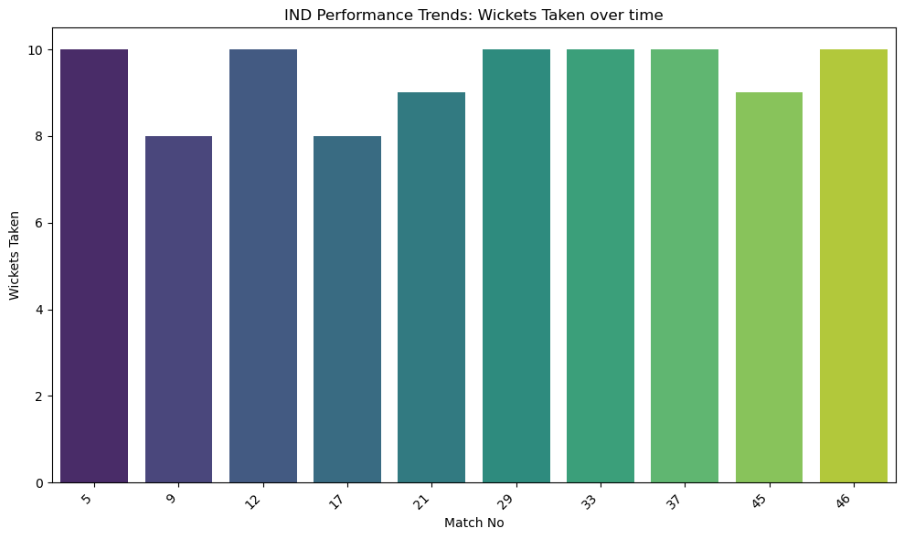
Temporal Analysis of India’s Performace : Bowling

Slide 14
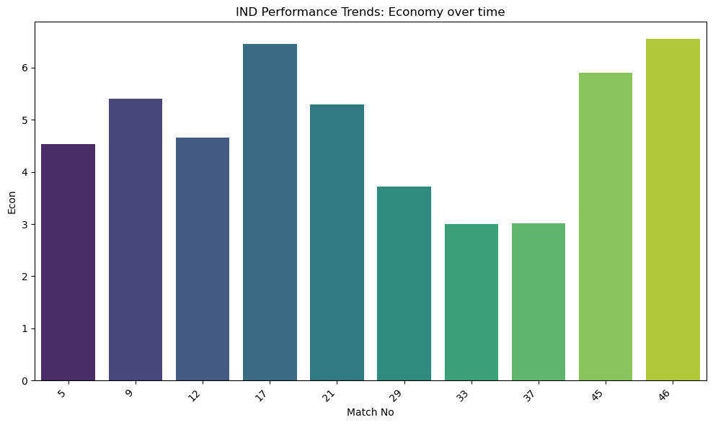
Temporal Analysis of India’s Performace : Bowling

Slide 15
Temporal Analysis of India’s Performace : Bowling

Slide 16
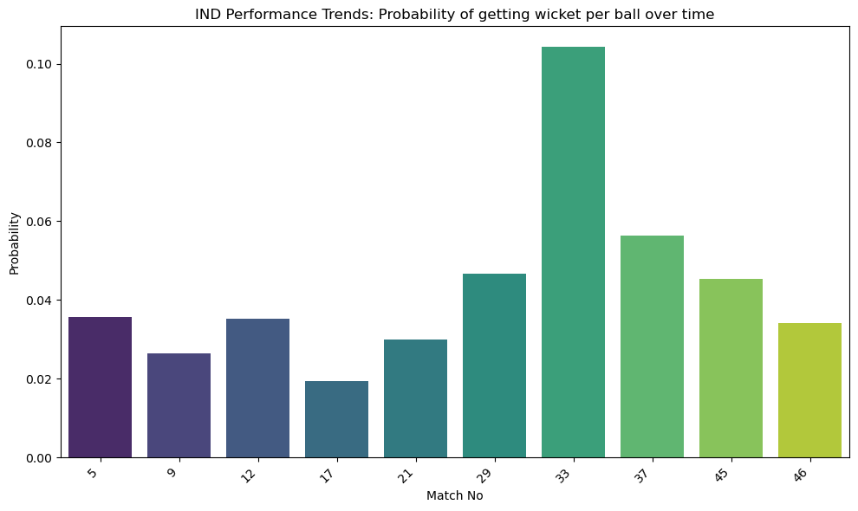
Temporal Analysis of India’s Performace : Bowling

Slide 17

Thank
you!
FOLLOW MENTORNESS

